Slide 1

https://blog.naver.com/hsh6051/221719949553
https://blog.naver.com/hsh6051/221277358931
https://blog.naver.com/hsh6051/221719930752

Slide 2

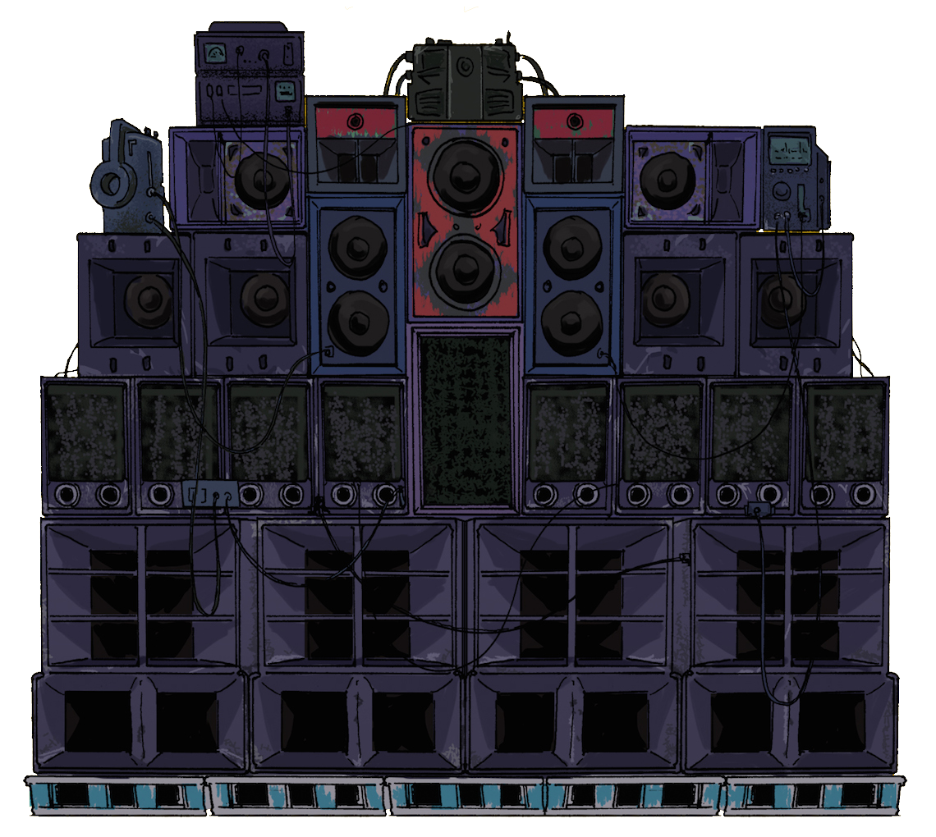

Slide 3
LET’S
ROLL THE
PRENSENTAION

Slide 4
LET’S
ROLL THE
PRENSENTAION

Slide 5
MY LITTLE DESIgn ROOM
PRESENT

Slide 6
BRAND NEW PPT
TEMPLATE

Slide 7
ENTER THE TITLE
20180702 HONG GIL DONG

Slide 8
contents
Title 1
Title 2
Title 3
Q & A

Slide 9
Title 1

Slide 10
Title 1

Slide 11
Title 2

Slide 12
Title 2

Slide 13
Title 3

Slide 14
Title 3

Slide 15
QUESTION
& ANSWER

Slide 16
QUESTION
& ANSWER
If you have any question?

Slide 17
Thanks
For watching!

